Slide 1
Music analysis

Slide 2
Gusty Garden Mario galaxy vs dark red

Slide 3
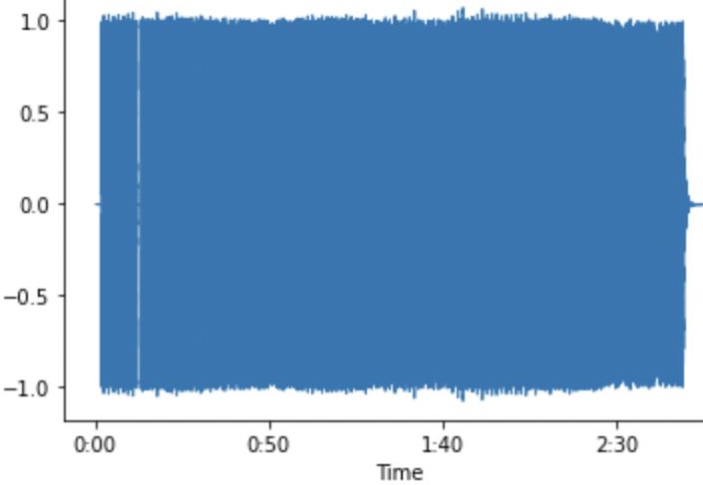
dark red
Dark red is a song by Steve Lacy that is written in the key of F♯ Major with a tempo of 172 BPM
Throughout the duration of Dark red, the amplitude of the sound remains stationary at 1.0 and only changes when the son ends, meaning that the song dynamics remain as forte/fortissimo. The intensity of the song, along with the frequency is very high which resulted in the distance between each period/wavelength between the waves being very short

Slide 4
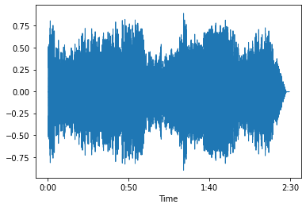
Gusty Garden Mario galaxy
Gusty Garden Galaxy is a song from the game Mario Galaxy which was composed by Mahito Yokota. It is written in the key of D♭ Major and C# Minor with a tempo of 100 BPM
Just like Dark red the sound starts off very strong/loud however after the first couple of notes, the sound becomes moderately softer and continues to alternate as the song continues. The intensity and the frequency, just like the amplitude, change as the song progresses. It starts off as very intense but start to become less intense. The distance between each period/wavelength are spaced out a bit more

Slide 5
comparison

Slide 6
Dark red and Gusty Garden Galaxy both start off as strong, however, the percussion in Dark red is more dominant than it is in Gusty Garden Galaxy
Gusty garden galaxy uses a wider variety of instruments such as trumpets, violins, cellos, etc. whereas Dark red it uses voice, drums, bass and electric guitar
Dark red is much louder than Gusty Garden Galaxy and does not change throughout
The distance between each period/wavelength are spaced out a bit more in GG Galaxy whereas in dark red they are more tightly together

